Slide 1



Super Store Sales Data
View in Power BI
Last data refresh:
6/13/2024 7:46:35 PM UTC
Downloaded at:
6/13/2024 7:48:48 PM UTC

Slide 2
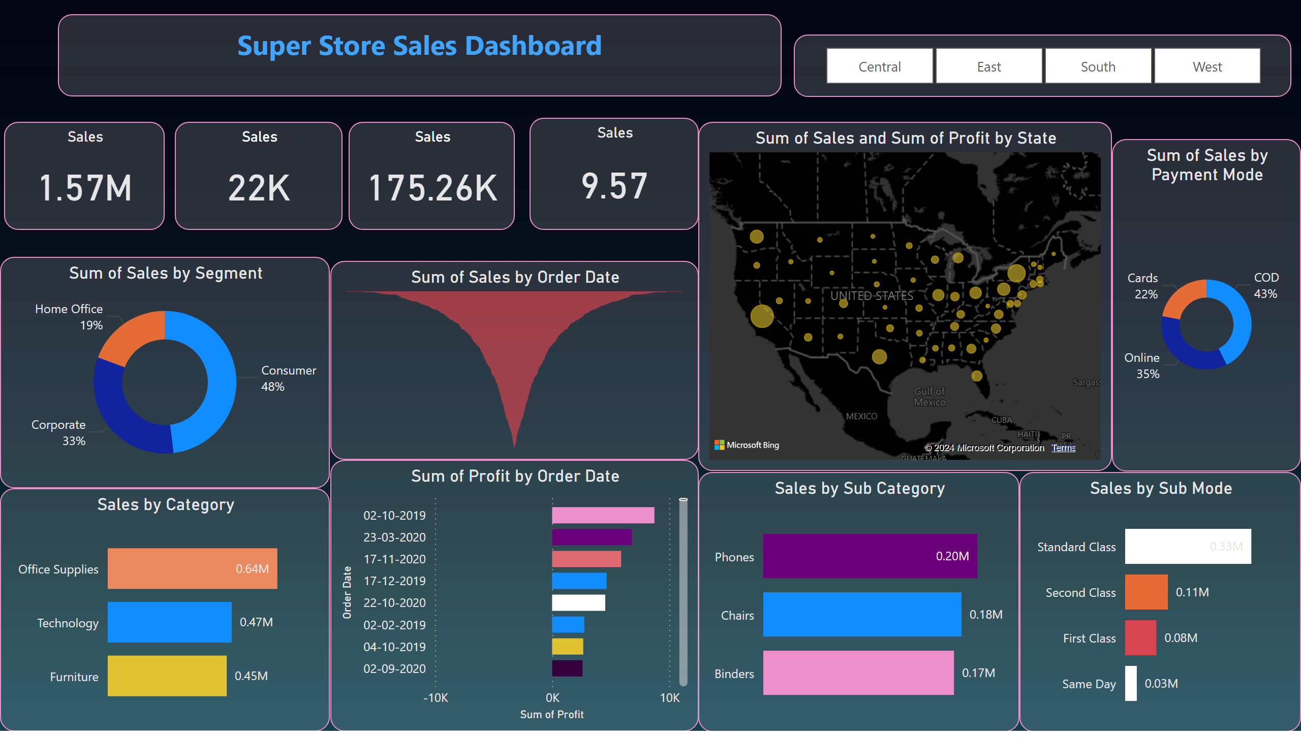
Page 1
Notes:
Sales by Category
No alt text provided
Sales by Sub Category
No alt text provided
Sales by Sub Mode
No alt text provided
funnel
No alt text provided
barChart
No alt text provided
map
No alt text provided
donutChart
No alt text provided
donutChart
No alt text provided
slicer
No alt text provided
textbox
No alt text provided
Sales
No alt text provided
Sales
No alt text provided
Sales
No alt text provided
Sales
No alt text provided

Slide 3
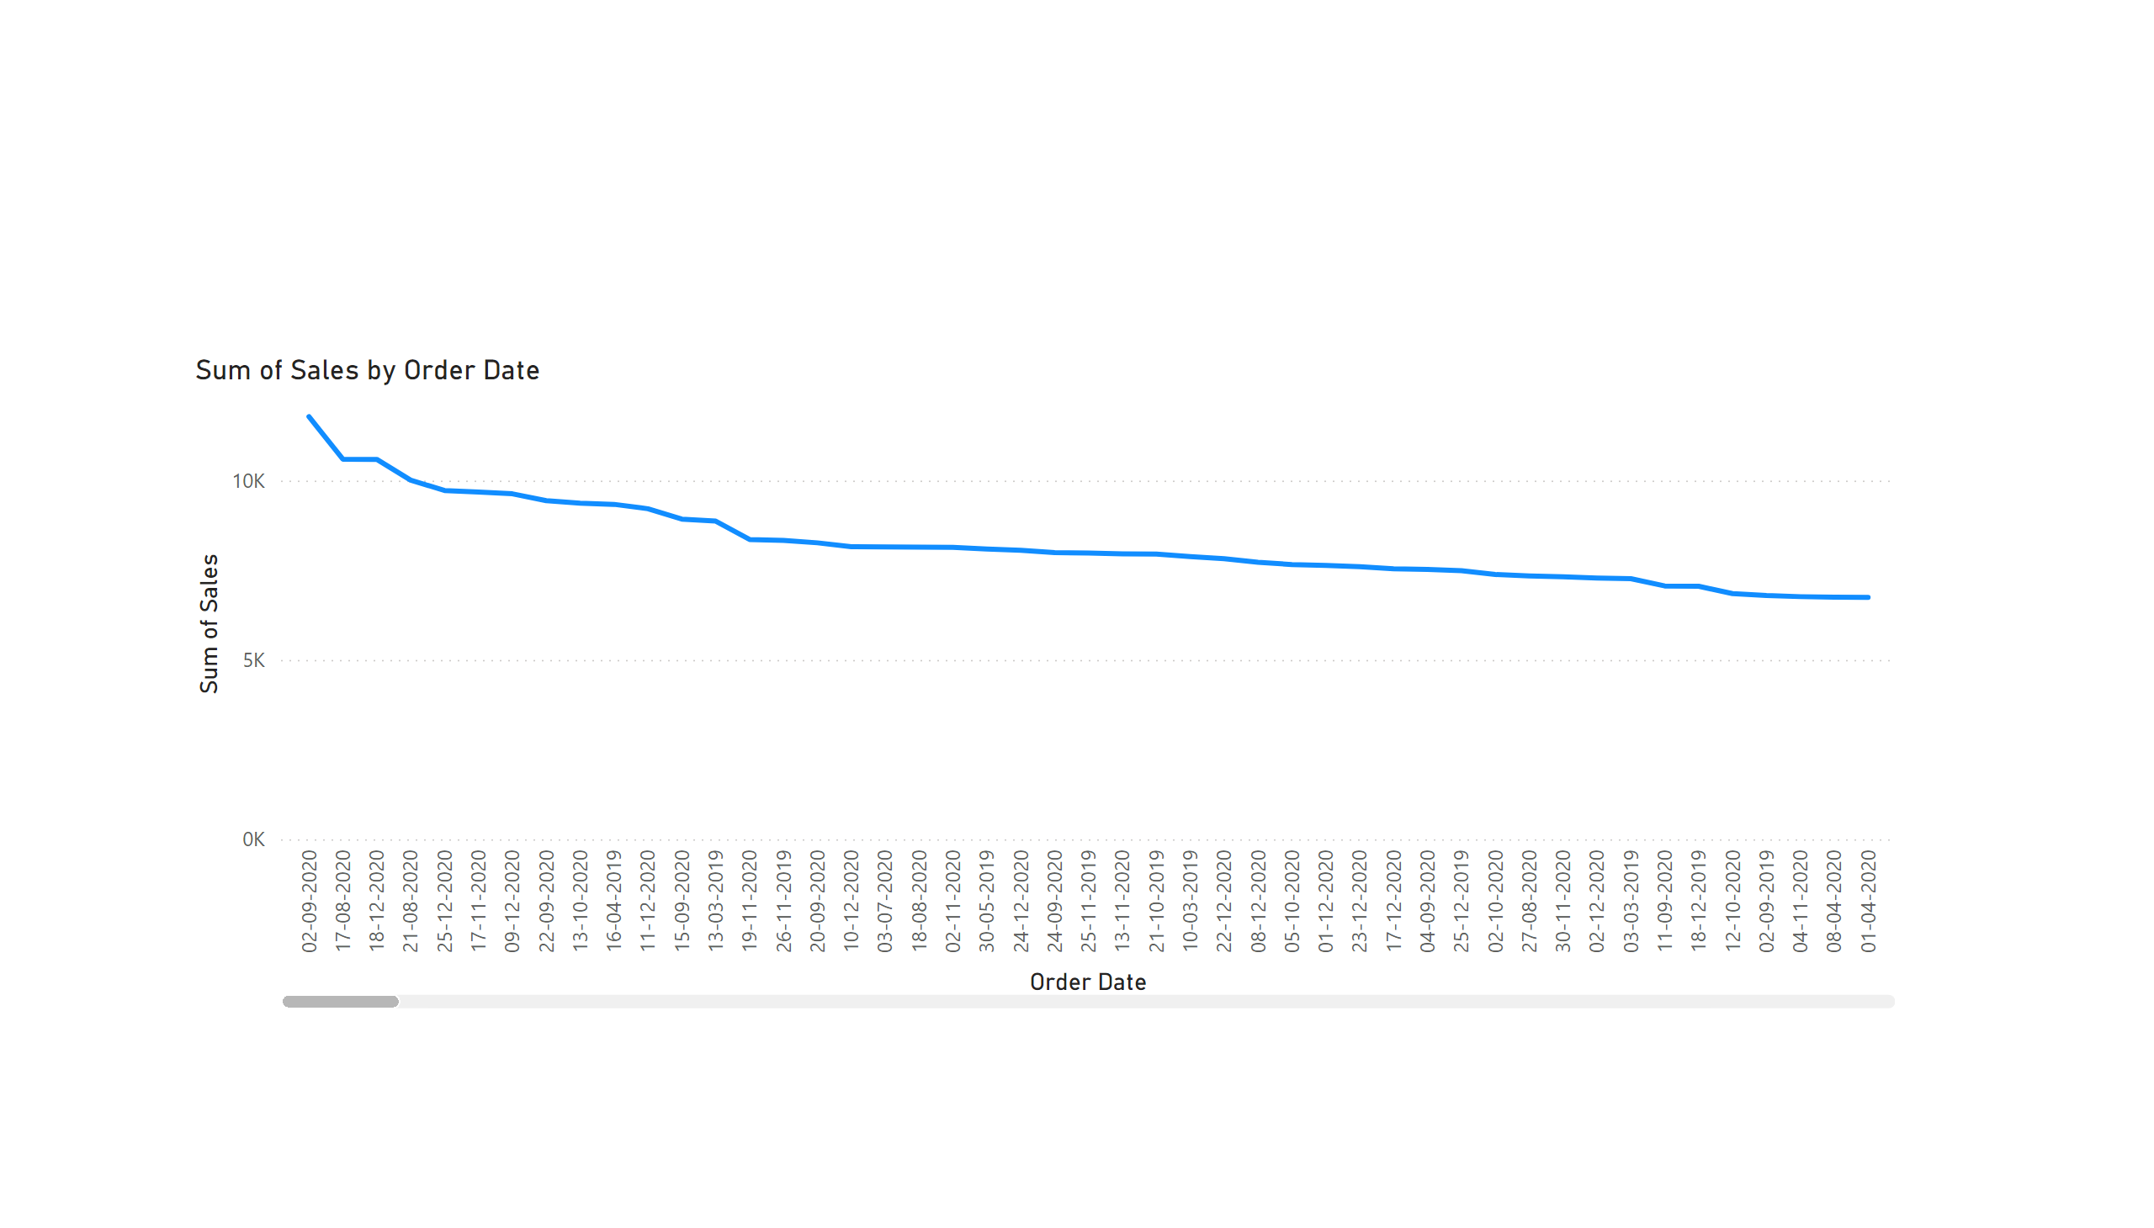
Page 2
Notes:
lineChart
No alt text provided

